Slide 1



Cart and Pole Control Problem
An woefully short and probably frustrating slide deck
Dr. Mario

Slide 2
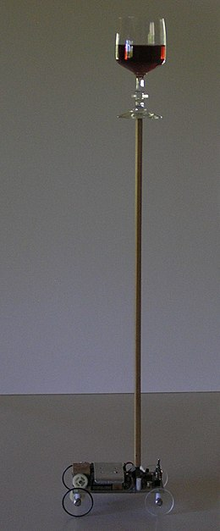
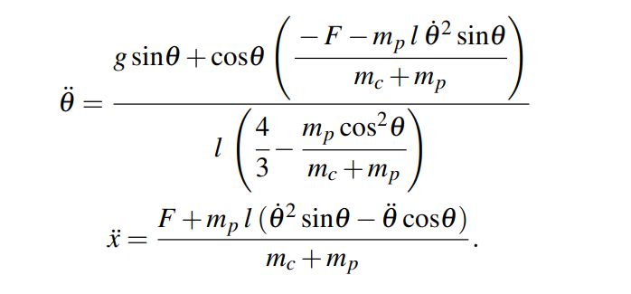
The great secret of the Cart and Pole Problem

Slide 3
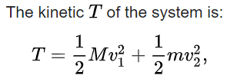
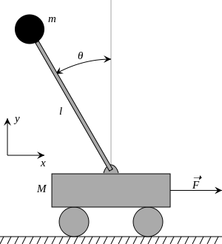
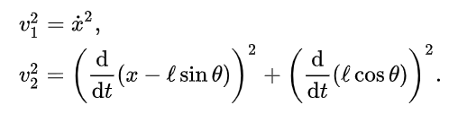

Walking Through The First Bit
The velocity terms for v1 is pretty simple. V2 has to consider the angular properties.
Jaxton is already thinking, this holds
https://en.wikipedia.org/wiki/Inverted_pendulum

Slide 4

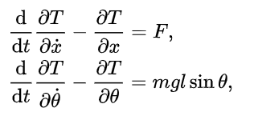

Walking Through The First Bit
New kinetic energy then must be:
According to Lagrange, these two below hold true (heroic assumption)
Substituting T into the Lagrange equations
https://en.wikipedia.org/wiki/Inverted_pendulum

